Slide 2
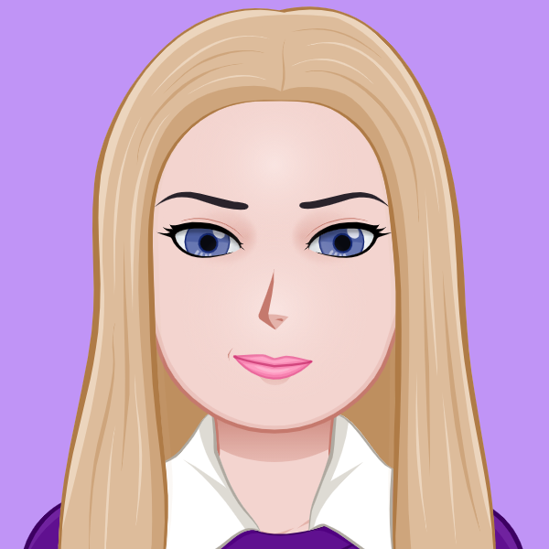
Erica
Ingram,
software
engineer
Notes:
Hello, my name's Erica Ingram, and I am a recent Lambda School grad seeking a position as I transition careers. Since my background is pretty non-traditional, I'm here to discuss that background and walk through a few of my projects to show you my capabilities. First, I'll go over a little bit about me prior to Lambda, my time at Lambda, some projects I've done, and then we'll close with a recap and contact methods.

Slide 3
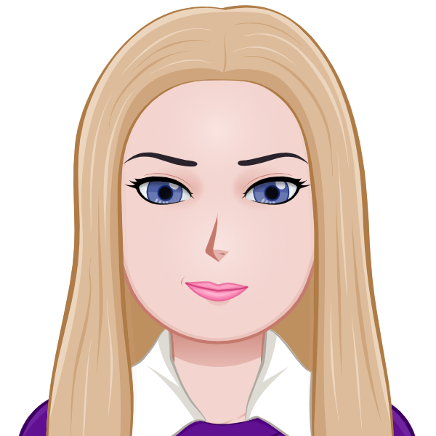
Background
retail
customer service
project manager at Kinkos
general news department manager of gaming league, readership over 500k
book published
magazine articles, including on front cover of Massive & Computer Games Magazines
member of extremely high-performing team in WoW, ranked 25 out of 10,000
Built my own computers
Notes:
I've been a hard worker and leader by example my whole life. My first job was detasseling for four full seasons. I've had jobs doing many different things, but much of my past has been technology adjacent. I’ve worked in retail, customer service, as a project manager @ Kinkos, run a news department for a gaming league with a readership of over 500k, and had a book published as well as articles featured on the front cover of both Massive and Computer Games Magazines.
I am a leader by example even when I am doing things for fun. For a year and a half, I belonged to a guild in World of Warcraft which was 25th in the U.S. out of upwards of 10,000 guilds to clear Sunwell Plateau, and was present for and participated in each and every boss kill. I was known for combat log analysis and helped mentor junior raiders by deeply analyzing logs and collaborating with other guildies to help juniors improve their rotations.
Until I started my business, I built my own computers for fun. So although I did many non-tech jobs, I never strayed too far away from technology.

Slide 4
About A Quo Co.
Founded in July 2009
Three years developing software in Access via VBA and MySQL
Used text-analyzing software on over 10,000 transcript pages to produce autocorrect entries, improving typing speed and accuracy
Automated creation of those entries in VBA
Completely unique transcript features such as citations , authority hyperlinking, and tables of authority
Results: Produced twice the number of pages as most of my colleagues
Notes:
Now, I've run my own court transcription business remotely for over a decade, and as is true for many solo-entrepreneurs, efficiency was key. So I spent three years developing software to automate as much of my workflow as possible with VBA and MySQL, integrating it with several APIs and programs. I used text-analyzing software on over 10,000 transcript pages to produce autocorrect entries in Word via VBA to improve typing speed/accuracy and automate creation of those entries via VBA. My transcripts offer completely unique features such as authority hyperlinking via CourtListener, .gov sites as well as tables of authority via VBA automation, and I consistently produce twice the number of transcript pages as most of my colleagues due to the same automation.

Slide 5
Lambda School
A computer science academy offering an immersive, online nine-month program to prepare students for a successful career in web development
Notes:
Now, from October until I graduated at the end of June, I attended Lambda School, a computer-science academy that offers an immersive, online nine-month program to prepare students for a successful career in web development.

Slide 6

Team Lead @ Lambda
Code review and 1:1s for every student in my team twice a week
Hosted stand-up meetings with seven students two to three times a week
Presentations on various resources to facilitate students' growth during stand-ups
Mentored and provided feedback to students on areas of improvement
Tracked attendance and other student metrics
Use of Slackbot and Slack Workflow Builder to manage tasks, information, and reminders
Notes:
For six months from January to June of this year, I served as team lead at Lambda School, where I performed code review & 1:1s for every student on team twice per week, hosted two stand-up meetings with six to seven students weekly, gave presentations to facilitate students' growth during stand-ups, mentored & provided feedback to students on improvement areas, tracked attendance and other student metrics, and used Slackbot & Slack Workflow Builder to manage progress. My time as team lead also included serving as project lead for several build weeks, where you have seven days to complete from design through deployment a real-world web application using Agile development and Trello for project management. For those six months, I went to school 40 hours a week, team-lead 15 to 20 hours a week, and ran my business in between.

Slide 7
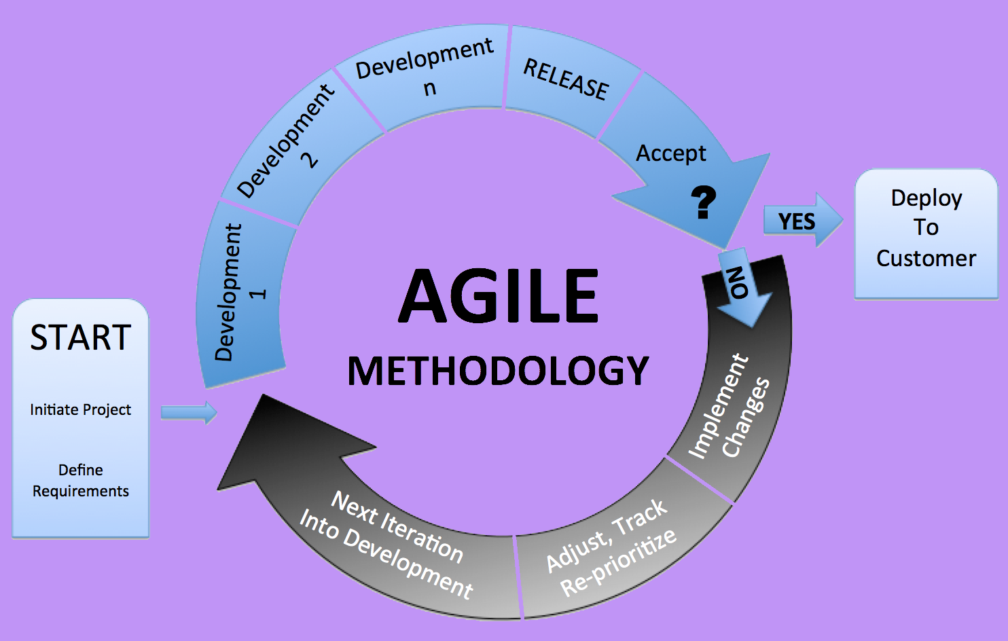
Agile
One Day = Module
One Week = Sprint
Four Sprints = Unit
MVP Goals + Stretch
Sprint Challenge
Module & Sprint Retrospectives
Stand-ups & 1:1s
Git
Lambda Git flow process
Over 5,800 GitHub contributions via Git
Notes:
The Lambda curriculum is completed in an Agile format. Each day is a module, each week a sprint, each unit four sprints. Every day, there are Minimum Viable Product (MVP) goals and one to five stretch goals due for that day's project. At the end of each week is a 'sprint challenge', which also has MVP and stretch goals. Every day, you complete a module retrospective and every week a sprint retrospective. Every day of the entire curriculum, you have both a stand-up with your team and team lead and also a 1:1 with your team lead to go over your code, discuss blockers, and stuff like that. For 29 out of 31 weeks, I not only met MVP for each day, but completed at least one stretch goal per day and in most cases multiple stretch goals. So I have lots of experience in Agile project management.
For the entire program, we are required to use Git and GitHub for version control with Lambda's Git flow process. I've had over 5,800 GitHub contributions in the last year, and all of them via Git, so I also have lots of experience in Git.

Slide 8
BOOKS
Design Patterns: Elements of Reusable Object-Oriented Software by Erich Gamma, Richard Helm, Ralph Johnson, and John Vlissides
Web Scalability for Startup Engineers by Artur Ejsmont
Clean Code by Bob Martin
The Clean Coder by Bob Martin
Clean Architecture by Bob Martin
Notes:
I read several books on the side during my time at Lambda; Design Patterns: Elements of Reusable Object-Oriented Software by Erich Gamma, Richard Helm, Ralph Johnson, and John Vlissides, Web Scalability for Startup Engineers by Artur Ejsmont, Clean Code, The Clean Coder, and Clean Architecture by Bob Martin, and I'm currently reading Agile Estimation and Planning by Mike Cohn.

Slide 9
PROJECTS
key features
tech stack
technical challenges
stretch goals
Notes:
Next, let's go over some projects chronologically. For each one, I'll go over some features of the site or app, its tech stack, technical challenges I ran into, and how I went above & beyond the curriculum for that particular project.

Slide 10
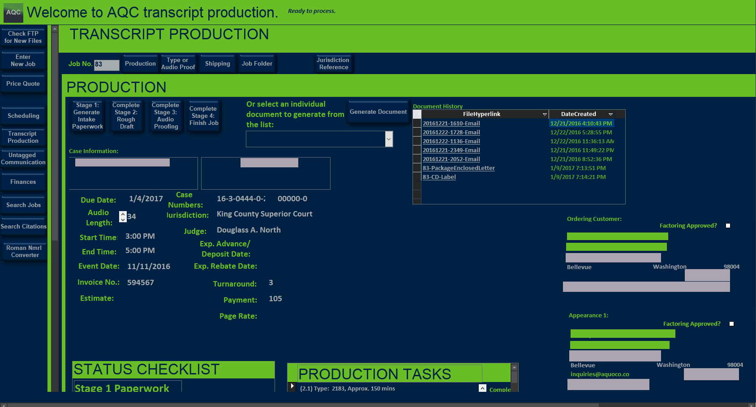
PROJECT:
COMPANY DATABASE
manages transcript production workflow & schedule
tracks communication
integrated libraries such as WinSCP & Acrobat
speech recognition
unique transcript features like tables of authority, automatic citation, & authority hyperlinking
Notes:
First, I'll go over the software I developed prior to Lambda. Frankly, it's probably my worst written code, being my first big project ever, but I'm extremely proud of it because of how many problems I solved with it and how much I learned developing it.
As one might imagine, I use Word extensively for my business. I was working so many hours, doing so many repetitive tasks, and got tired of entering the same data into more than one place and having to remember so many details that I felt could be automated with VBA. So I wrote some VBA macros to deal with a couple of problems, integrating Excel. Then I started writing little chunks of code for many other issues/problems I was having in my business that caused me to have to work so much. I became good at debugging because, if I couldn't figure it out on my own, the feature simply wasn't going to happen. But at first, admittedly, sometimes it would take me days or weeks to figure something out.
Eventually, stringing all these chunks of code together didn't make any sense. I needed a full program to manage my business, and I wanted to know more about what Office does so I could automate absolutely everything possible in my business. So I took two to three buses to the library up in Shoreline for several weeks to get MOS certifications because the King County Library system offers those tests for free. Then I used that knowledge to automate even more stuff in my business and wrote a full-featured piece of software in Access with VBA and MySQL. It manages my entire transcript production workflow, my schedule, tracks communication, and is integrated with many libraries such as WinSCP and Acrobat, among doing many other things. It even has a speech recognition component. I offer, for free because of VBA automation, transcript features no one else does like tables of authority and automatic citation and hyperlinking of authority (case law, rules, regulations, statutes, etc.) mentioned in transcripts. Attorneys charge their regular billable hourly rates for this.

Slide 11
PRODUCTION WORKFLOW
STAGE 1:
INTAKE
STAGE 2:
TRANSCRIBE
STAGE 3:
AUDIO PROOF
STAGE 4: DELIVERY
Notes:
Now, I need to briefly go over the general workflow of my business because this will be relevant to a couple of projects later. This software was designed to match the production workflow of the business using principles from the Getting Things Done system. I designed the production workflow before developing the software for my business by writing down every single thing my business needed to do to produce a transcript in order and developing a workflow based on that list.
A job or transcript goes through four stages; intake, transcribe, audio-proof, & delivery.
In stage 1, intake, the customer fills out the order form online, the info is sent to the back end, & initial processing of the data happens, to include document creation, spellings confirmed, & folders, files Word shorthand auto-generated.
In stage 2, the audio is transcribed using my custom shorthand dictionary. I created this dictionary by analyzing over 100,000 transcript pages for word count and developing shorthand based on that analysis. An example of such shorthand would be typing 'dout' for 'do you think', where you type four letters and hit space, but 12 letters and the space appear. This alone saves me untold amounts of time and effort.
In stage 3, the shorthand is automatically translated & document automatically formatted to a print-ready transcript. Hyperlinks & citations are auto-generated & confirmed via either a database table, the CourtListener API, or by human Google search, & then the document is proofed to audio by an actual human, the gold standard in court transcription.
Stage 4, delivery, includes generation of a word index & various transcript formats, ZIP files for client delivery. The invoice is settled, & last but not least the transcript is delivered to the customer. Everything I just described here as automated are features I developed in this software.

Slide 12
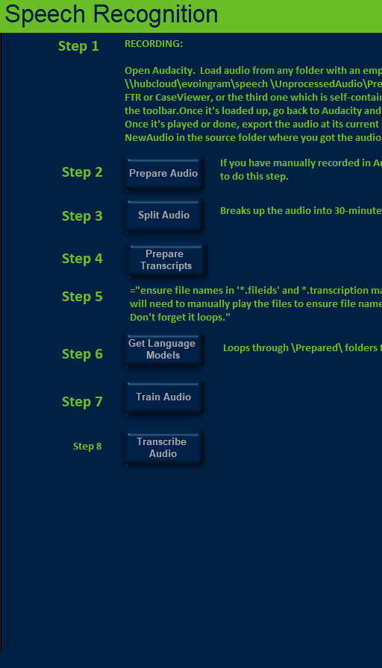
SPEECH RECOGNITION
Visual Basic
Batch Files
PocketSphinx
Notes:
Towards the end of the development of my Access program, I then wanted to build a speech recognition engine with automatic transcript and audio feeding from my Access software so that it would auto-learn from transcripts I already produced and also automatically produce a transcript with the current audio, and I actually did successfully do that with Audacity, VBA, batch files, and PocketSphinx. I even created an Access form for it. But sadly, PocketSphinx doesn't have nearly enough memory for what I need it to do, and I haven't had time to go back and remedy that, but it's in my future plans.

Slide 13
PROJECT: VB DATABASE
Notes:
You can see the main window here. Each of the four stages is automated in the sense that, when I've completed my tasks, I click the appropriate button and it will complete all the automated tasks I've programmed it to do. You can see the general job information is here, and if I want to manually generate a document, I simply select it from this menu and press the button.
I have several other options on the left here for other business tasks I can do, like sending a price quote to a customer. I simply enter the audio amount and turnaround time, click the button, and it will give me a price quote with the option to generate an email for the price quote as well as tell me if I can handle the job with my current schedule. This last feature helps me not overbook myself or overcommit, which is a problem that I had for many years.
What I'm most proud of about this software is how many problems I solved in my business with it, both business problems and personal weaknesses. Its future is uncertain at the moment since I am currently developing updated and improved online versions of the same software.

Slide 14
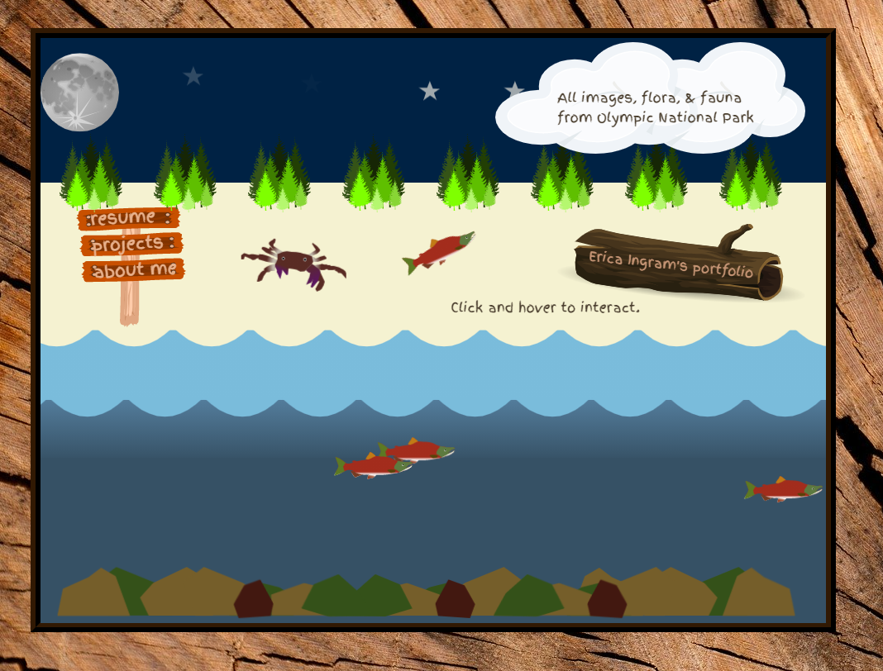
PROJECT:
PORTFOLIO
Tech Stack:
HTML
CSS
JavaScript
Olympic National Park theme
Notes:
The next one I want to go over is my portfolio, which was built with HTML, CSS, JavaScript, and the GitHub contributions calendar app. The portfolio is a work of art I created with a theme of Olympic National Park, a beautiful and unique temperate rainforest just over on the peninsula from where I live that holds many amazing flora and fauna. I made this after the first Lambda unit to both solidify the skills I had just learned as well as go above and beyond the curriculum with CSS animation. One day on Codepen, I saw so many amazing examples of complicated pure CSS animation that I wanted my portfolio to have the same artsy look with a theme meaningful to me.

Slide 15
PROJECT: PORTFOLIO
Notes:
So that's exactly what I did. I love Olympic National Park, so I did lots of research on the various animals and plants there as well as the landscape there to make a realistic scene. I used Illustrator to make the crab, salmon, and log. The water, beach, and sky were made using pure CSS. This page is very heavy on CSS animation, and as such is minimally responsive. All the animation you see is pure CSS animation. The site has two responsive settings, mobile and desktop. You can toggle between sunny and twinkling starry skies, and the cloud holds text that changes as you hover over different items. This happens all while a crab walks on the beach and salmon swim in the water. Click on the different options on the beach sign to see different modals.
My biggest technical challenge in this project was getting everything to line up properly. This is quite a few items to line up one behind the other and in exactly the right spot, so most of my time on this project was spent doing just that.

Slide 16
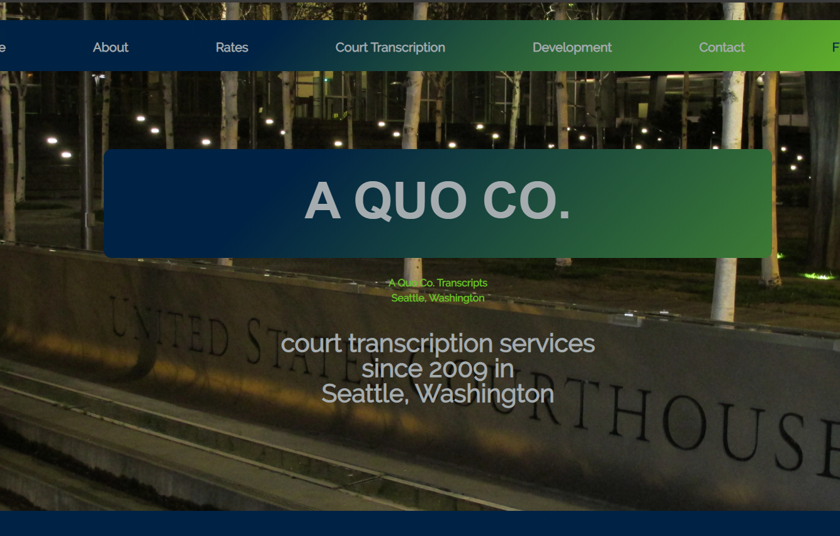
PROJECT:
COMPANY WEBSITE
Tech Stack:
HTML
CSS
JavaScript
LESS
Notes:
The next project I'll discuss is my company's website, a very responsive website I built for my company after unit one, again to solidify my knowledge and go above and beyond the Lambda curriculum. Adam Ingram took the background image and designed all wooden ad images you see on this website. I built the website using HTML, CSS, JavaScript, and LESS.

Slide 17
PROJECT: COMPANY WEBSITE
Notes:
This page features pure CSS gradients, a generally well-known overall site design, and a price quote calculator. All internal links on the main page are a pop-up to other hidden sections on the same page. As you saw, it contains animation in the showcase image and in each stripe going down the page. The code is separated into separate LESS files and uses several mixins; one for animation, several for color manipulation according to color scheme, some flexbox ones, and an order/z-index one. It has an image carousel to display pictures of unique transcript features, an inside-out underline animation for links, a FAQ with expandable questions, and a sticky header menu. It's pretty responsive with desktop, tablet, and mobile versions.

Slide 18
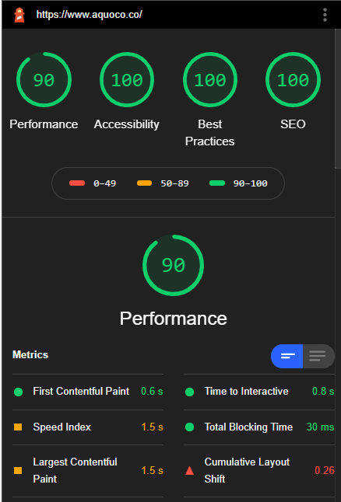
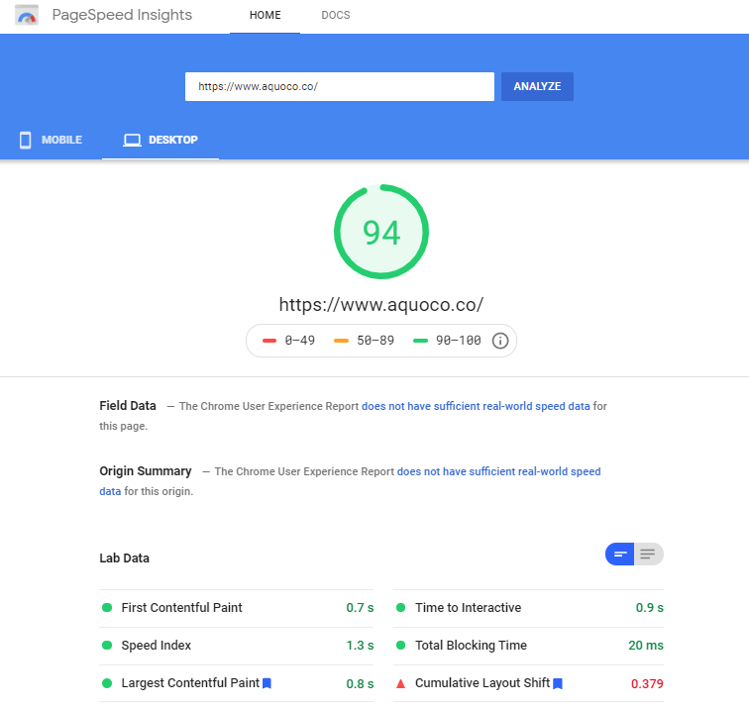
Notes:
It ranks in the 90th percentile in Google PageSpeed Insights, and on Lighthouse reports ranks 90 in performance and 100 for accessibility, best practices, and SEO. It ranks on first-page results for "Seattle transcription" in Google and page two for Bing/Duckduckgo. It is the fourth iteration of the company website over my company's history, so this site has come a long ways since its early days.

Slide 19
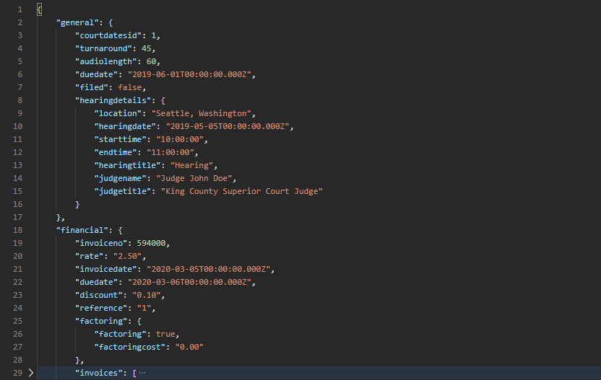
PROJECT:
COMPANY BACK END
Tech Stack:
Node
Express
Knex
bcrypt
PostgreSQL
126 endpoints, 23 tables
fully documented w/ Postman, schema, product vision
Notes:
To the next project, now, once I started learning React in unit two and three, I knew I wanted to take my VB database online and to improve upon it. So when I learned Node for back end work in the fourth unit at Lambda, I made a 126-endpoint, 23-table API built with Node, Express, Knex, bcrypt, and PostgreSQL. It is fully tested & documented with Postman & has third-party API support for CourtListener, a wonderful publicly available case law API, Xero, PayPal, Wunderlist & Office.
The back end adheres to RESTful API best practices & gold standards as much as possible. What you see here on the right is a sample response from one of the endpoints, and --

Slide 20
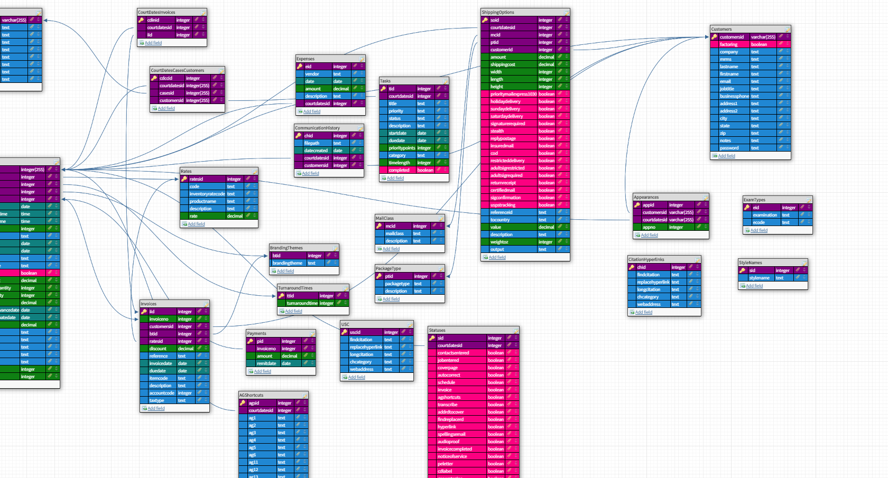
SCHEMA
Notes:
-- here's the schema. You can view a list of endpoints, full Postman documentation, the schema, a couple of UML diagrams and the product vision document for the overall software in the readme if you want to check it out. It's intended to support a React-Redux-TypeScript front end, which is still in planning stages due to time constraints.
This project goes above and beyond the Lambda curriculum because it utilizes fairly advanced SQL statements via Knex query builder, and because this back end was entirely 100 percent separately developed apart from school. I used my Lambda knowledge to solve actual real business problems by making the back end portion of my earlier-developed VB software.

Slide 21
PROJECT: COMPANY BACK END
Notes:
My biggest technical challenge was putting all the pieces together in the right way for this particular endpoint, and if you remember my spiel earlier about the general flow of the business, you can see this endpoint's data is designed like that as well.
In the future, I plan on adding search and sort parameters as well as testing via Cypress.

Slide 22
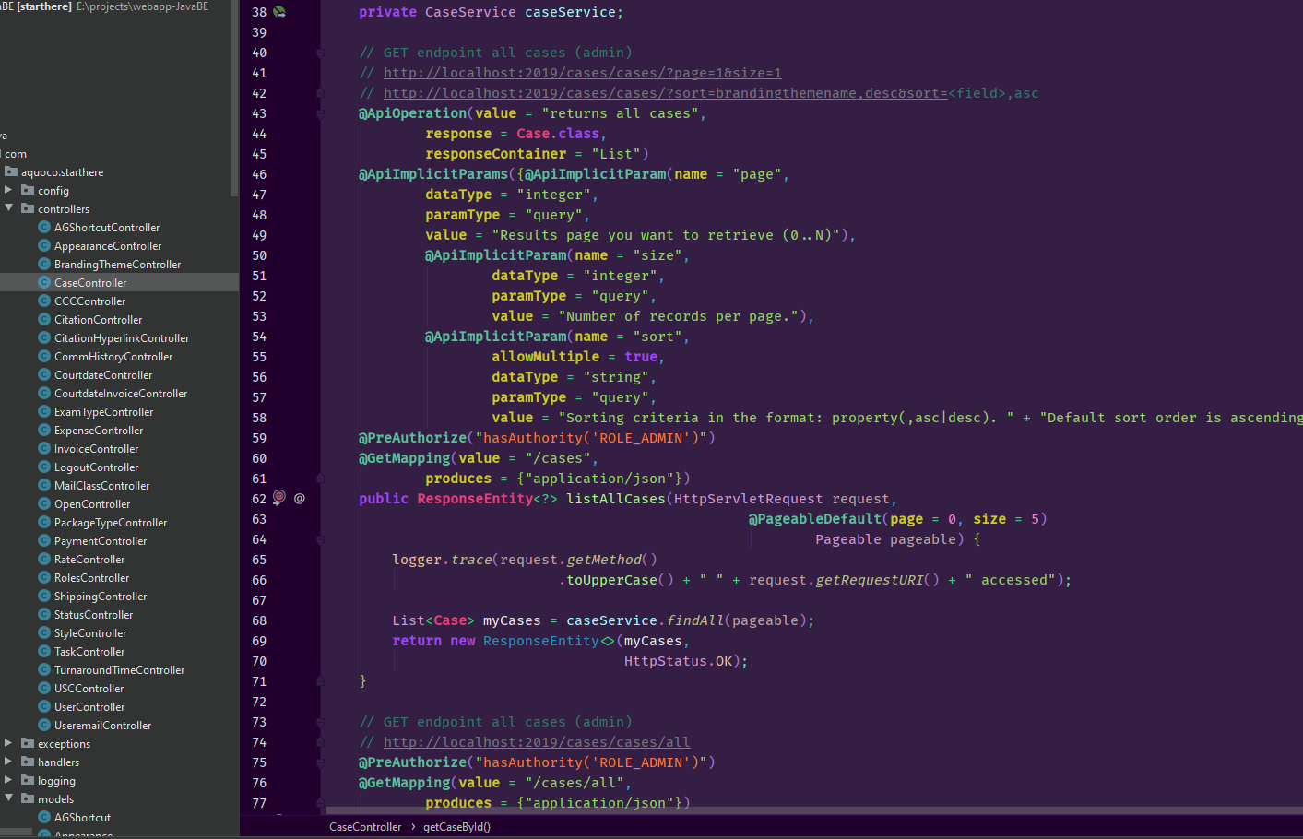
PROJECT:
JAVA COMPANY BACK END
Tech Stack:
Java
SQL
Java Spring
PostgreSQL
JUnit 4
SLF4J
OAuth2
Swagger
Maven
Notes:
Something I did on the side at Lambda was take their Java back end curriculum. It wasn't an option when I began attending, but normally you can choose one of two back end paths; Node or Java. So my only option was Node at the time, but nonetheless the curriculum was available, so I took the time to learn it on the side because I knew it would make me more valuable as a developer.
After completing the curriculum, I then decided to make a version as identical as possible to the Node back end only in Java. So this entire project and everything I learned prior to doing it went above and beyond the curriculum. I built this back end with Java, SQL, Java Spring, JUnit 4, SLF4J, OAuth2, Swagger, PostgreSQL, and Maven. It has roughly the same schema and does the same things, but with a couple of added user tables/features.

Slide 23
PROJECT: COMPANY JAVA BACK END
Notes:
In contrast to the Node back end, the Java version supports multiple emails per user and different user roles, and its endpoints are more fully tested and support searching by different fields, sorting and query parameters, which the Node back end doesn't have at this time. So the Java back end will have a few hundred more endpoints than the Node back end when complete for that reason. I actually like this back end more than the Node one because of all its additional features. You can view a list of endpoints and full Postman & Swagger documentation in the readme if you want to check it out.
This back end, like the Node version, is intended to support the same React-Redux-TypeScript front end. This project was started during computer science, a few months after building the Node back end, and continues even now.

Slide 24
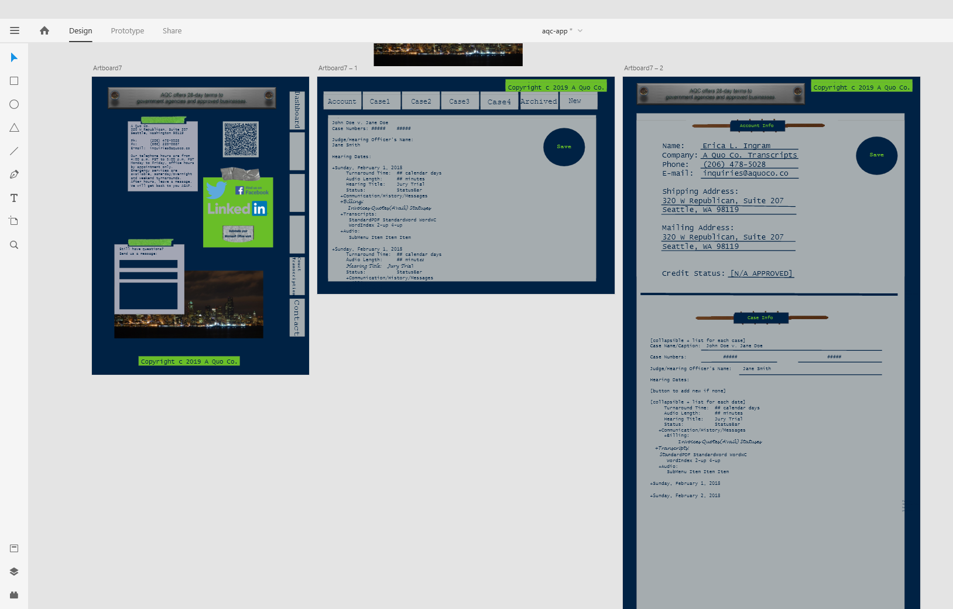
ADOBE XD FILE FOR FRONT END
Code: https://www.github.com/evoingram/webapp-frontend
Notes:
You can visit the front end intended for this back end at my GitHub, but it's still in planning stages, so I won't be covering it here. There is some documentation you can check out, including an Adobe XD design file for it.

Slide 25
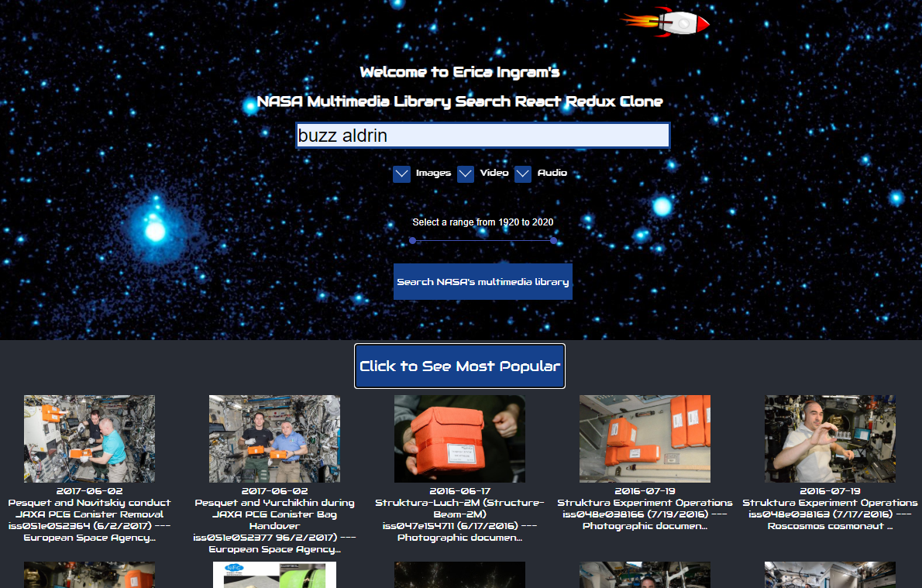
PROJECT:
NASA IMAGES LIBRARY CLONE
Tech Stack:
React
Styled Components
Video React
Redux
Axios
Notes:
Now, we'll go over a couple of front end projects I've worked on. The first front end project I want to show you is a NASA Images Library clone using the NASA API. I love NASA, had never seen anybody do this particular clone before, and the original wasn't in React, so I felt it was a good project to help me solidify my knowledge and learn more above and beyond the curriculum after completing unit two and three, the React units in the Lambda curriculum. I built this using React, Redux, Styled Components, Video React, Axios, and Cypress. It also has a couple of animations, a rocker in the header and an astronaut in the footer.

Slide 26
NASA ORIGINAL v. CLONE
can download many file sizes | only original available (future feature)
EXIF data | no EXIF data (future feature)
tooltips to display extra info in search results | grid view to eliminate tooltips for accessibility
displays textfield w/ file URL & link to same URL | displays no textfield, only button to download file
three share options | nine share options
displays breadcrumbs in top left AND right side of detail page | displays same info on right side only of detail page
displays keywords and links them to search | displays keywords, unlinked, as search is always in header
search results always have a left-hand sidebar which contains search features that are not available until after first search | full-featured search function always in header & available from first search, left-hand sidebar eliminated
Center website linked on 'Visit Center Website' text, center initials not linked | no 'Visit Center Website' text, center initials linked
Notes:
Now, it's mostly like the original but I've improved it in a few ways. The original has tooltips to display extra info in search results, but my version has a grid view to eliminate tooltips for accessibility improvement such as breadcrumbs and duplicative center and search term links.
Mine saves screen space over the original by not displaying duplicative information in certain places.
The original offers only three share options, whereas mine offers nine.
In the original, the search results always have a left-hand sidebar which contains search features that are not available until after first search, but the clone has a full-featured search function always in header & available from the very first search. The left-hand sidebar is totally eliminated.

Slide 27
PROJECT: NASA IMAGES LIBRARY CLONE
Notes:
My biggest technical challenge on this project was the nesting and organization of components. I spent several days on this and ended up collaborating with a Lambda colleague to solve this. This project really helped me solidify my React understanding a ton, as I struggled greatly with understanding how it was organized and how data flowed through React apps.
In a future release, I plan to complete Cypress testing and refactor so it reflects what I've learned in the Clean series. I'd also like to draw some UML diagrams for it during the refactor just as a further learning exercise.

Slide 28
A way for people to:
gather
collect and stay in contact with people that you meet
to make the social and connecting aspect of events effortless, seamless and fun to do
to give courage and ability to less outgoing people to connect and network more comfortably
to unify the social and personal networking aspect of events and put that in the hands of participants instead of vendors
PROJECT:
SWAAP
Notes:
Now we come to the Swaap app. In every track at Lambda, each student goes through an eight-week 'apprenticeship', called Labs. The student collaborates in two full continuous development cycles using Agile methodology from design through deployment, working in cross-functional teams. The app I worked on in Labs was called Swaap, a way for people to gather, collect and stay in contact with people that you meet, to make the social and connecting aspect of events effortless, seamless and fun to do, to give courage and ability to less outgoing people to connect and network more comfortably, to unify the social and personal networking aspect of events and put that in the hands of participants instead of vendors.

Slide 29
TECH STACK
React
Auth0
Reach Router
Tailwind CSS
Notes:
The tech stack for the front end, which is what I mostly worked on, included React, Auth0, Reach Router, and Tailwind CSS.

Slide 30
FEATURES
giving users the ability to connect with each other through the app
getting and storing contacts in a fast and simple way
contact messaging ability
finding out where you met the contacts
Notes:
Some features include giving users the ability to connect with each other through the app, getting and storing contacts in a fast and simple way, contact messaging ability, and finding out where you met the contacts.

Slide 31
PROJECT: SWAAP
Notes:
My role in this project was to test all parts of landing page, make styling changes, add a contacts search feature, assist in planning phase & creation of product vision, and present release canvasses & product vision for approval to product owner. The biggest challenges for me in Swaap were not so much technical, but rather learning what to actually test and putting together a coherent, cohesive, concise presentation for a non-technical audience.

Slide 32
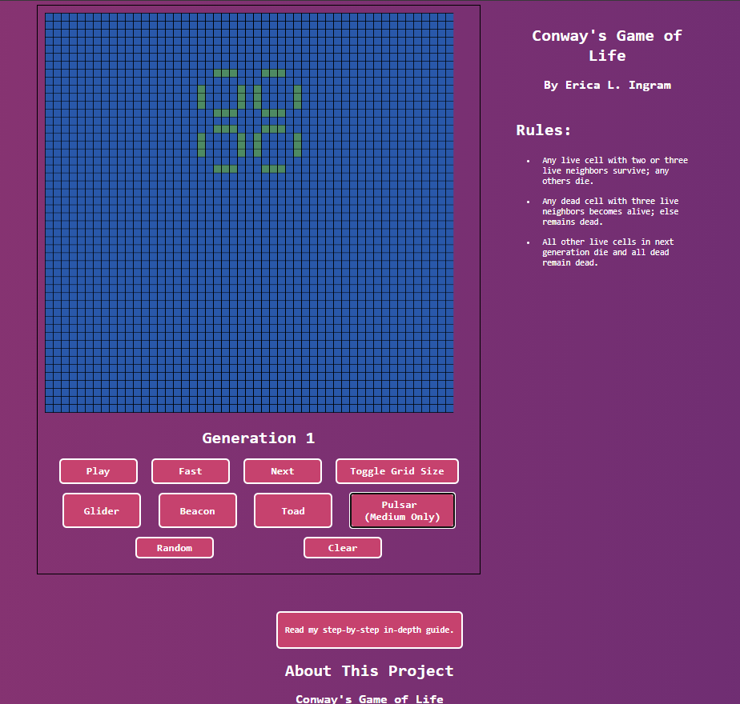
PROJECT:
CONWAY’S
GAME
OF
LIFE
Tech Stack:
React
Node-Canvas
Styled Components
Notes:
This project was a build week project during the two computer science units, to build the famous Conway's Game of Life. Lambda encouraged everyone to build it in their core language, which for me was JavaScript, because by that time we hadn't touched JavaScript in a couple of months. I built this for that assignment using React, Node-Canvas, and Styled Components. Our app had to meet several objectives which may be found in the repo.

Slide 33
MVP OBJECTIVES
Create a few sample cell configurations
Add an option that creates a random cell
Incorporate additional cell properties like color or size
Allow users to specify the speed of the simulation
Provide functionality to manually step through the simulation one generation at a time
Allow users to change the grid dimension
Allow users to skip ahead _n_ generations
Notes:
Additionally, the assignment was to implement three of a selection of seven features:
1. Create a few sample cell configurations that users can load and run
2. Add an option that creates a random cell configuration that users can run
3. Add additional cell properties, like color or size, and incorporate them into your visualization
4. Allow users to specify the speed of the simulation
5. Provide functionality to manually step through the simulation one generation at a time, as opposed to animating automatically
6. Allow users to change the dimension of the grid being displayed
7. Given a specific generation, calculate the configuration of cells at that point in time, and jump to that state, bypassing animation (i.e. skip ahead _n_ generations).

Slide 34
STRETCH OBJECTIVES
Implement 2+ additional custom features from MVP objectives
Deploy your app to a hosting service
Write a how-to guide or blog post
Expand your simulation into the third dimension
Explore alternate algorithms for finding the nth generation
Notes:
So to go above and beyond the curriculum, we had to complete at least one stretch goal from the following objectives:
1. Implement 2+ additional custom features, above
2. Deploy your app to a hosting service or, for iOS, to TestFlight (or the App Store!). Web devs can see [more deployment info here](resources/deployment).
3. Write a how-to guide or blog post that walks readers through the work you did to implement your project
4. Expand your simulation into the third dimension. Google `3D Conways Life`. Google for how to do 3D stuff on your platform. Web users might check out [3D-ThreeJS](https://github.com/LambdaSchool/3D-ThreeJS), and iOS might look at [SceneKit](https://developer.apple.com/scenekit/).
5. Explore alternate algorithms for finding the nth generation, such as [Hashlife](https://en.wikipedia.org/wiki/Hashlife)

Slide 35
PROJECT: CONWAY’S GAME OF LIFE & BLOG BACK END
Notes:
My project includes a gradient animation in the background, which I had never done before, and selected features #1 through #6 from the first list as well as #1 through #3 from the stretch goals list for my project. The big technical challenge for me on this project was visualizing translating the game from my head into actual code, which I overcame by simply just drawing out different aspects of this app on paper a lot. You can read more about my day-to-day for this project and an overall report about Conway's Game of Life at the live web app.
The last project I'll cover just briefly because I learned some key things while completing this project. This API is a blog back end I built with Node, Knex, Express, bcrypt, and PostgreSQL post-graduation. Like the previous Node back end I built, it is tested and documented in Postman, and you can view all the documentation in the GitHub repo as well as a Postman collection of all the endpoints. There are two notable parts to this API; one, I learned how to cache endpoint responses and caching is a feature of this API, and two, there are many query parameters for the GET endpoints in this back end. You can filter both authors and posts by tag, and sort both authors and posts by their respective fields, ascending or descending. You can also search by each field, partial matches included. I also included most-liked and most-read endpoints, which returns a list of the 20 most liked or read posts.

Slide 36
BEYOND THE LAMBDA CURRICULUM
Java
TypeScript
UML
advanced Postman
advanced Agile methodology
PowerShell
advanced Visual Basic
system design
scalability
object-oriented analysis & design
23 object-oriented design patterns
Approx. 40 system designs
2019 Master the Mainframe contest
Four IBM mainframe-related badges
hundreds of hours on LeetCode & Cracking the Coding Interview style problems
Notes:
There are several other things I learned on the side over my time at Lambda besides Java. I learned TypeScript, Docker, UML, advanced Postman, advanced Agile methodology, PowerShell, advanced Visual Basic, system design, scalability, and object-oriented analysis and design, including 23 object-oriented design patterns. I studied about 40-ish system designs to learn system architecture, including Twitter, Netflix, Pastebin, and others. I completed the entire 2019 Master the Mainframe contest, parts one through three, and a few other mainframe-related badges, and am working on 2020's contest currently. I spent hundreds of hours doing Leetcode and Cracking the Coding Interview problems in Python as well as reviewing both Anki flash cards I made and over 1,200 pages of handwritten notes. I've also done research on how to be productive as quickly as possible at a new developer job, how to get the most out of stand-ups and 1:1s, and things like this.

Slide 37
CAREER TRANSITION
full time position
diverse culture
work-life balance
current business not an impediment to having a full-time position
Notes:
What am I looking for in a career transition? I am seeking a full-time position in software engineering at a company that values diversity and offers good work-life balance. I plan on outsourcing all work and developing my company's software on the side as a hobby once I find the right position, so in no circumstances will I be doing both jobs at the same time. My business is currently extremely reduced so I can devote my time to the job search, and it will continue this way into the foreseeable future.

Slide 38
SUMMARY
Over 2.3 million lines of code
Over 5,800 GitHub contributions
Both leadership and real-world development experience
Studied several languages, frameworks, and fundamental computer science books outside the Lambda curriculum
Moderate Agile and Git experience
Notes:
In summary, during my time at Lambda, according to Sourcerer, I've written over 2.3 million lines of code in over 5,800 GitHub contributions, and I have both leadership and real-world development experience to draw from for my next venture. I've used what I learned both in and outside Lambda to solve real-world problems in unique projects. I've studied many things on the side, including several fundamental computer science books outside the Lambda curriculum, and have moderate Agile and Git experience.

Slide 39
REFERENCES
Bobby Hall, Direct Manager, Team Lead “Erica is a great team member and works very hard. She is enthusiastic and organized. Erica asks for support when needed and not afraid to speak out during conversations.”
Katrina Dierking, Direct Manager, Team Lead “Erica is a leader by nature. She has appropriate confidence and the ability to see the big picture of any project. She doesn't let anything rattle her. She would be an amazing asset to any team. She's a pleasure to work with.”
Chad Rutherford, Colleague, iOS Developer “Erica is a kind-hearted, hard-working individual. She goes above & beyond to make sure her work gets done in the time frame provided. While devoting her time to sharpening her skills is her priority, she is not afraid to dive into the unknown & try out a new library to accomplish a task.“
Daniel Mattox, Colleague, Web Developer “Erica was a pleasure to work with, able to tackle tasks ahead of other students consistently with little effort, and great to pair program with.”
Notes:
I've received 14 references, seven on LinkedIn and seven more via Searchlight, a third-party service which hides nearly all the recommender's content from the recommendee in order to encourage candor, which may be sent on request via e-mail. Here are some examples of them.

Slide 40
CONTACT
ME
Phone: 425 610 7447
Email: me at ericaingram dot tech
Portfolio: http://www.ericaingram.com
LinkedIn: https://www.linkedin.com/in/aquocotrans
GitHub: https://www.github.com/evoingram
Resume Markdown: https://gist.github.com/evoingram/ 3f73c92881179f4abcb4e9ee7c13a82f
Resume PDF: https://www.aquoco.co/Erica_Ingram_Resume.pdf
Notes:
I'm a high-performing team player. I learn quickly, and get results. As you can tell from this video, I will always bring my A game, and will take my resourcefulness, discipline, empathy, respect, problem-solving ability, teamwork, and grit with me wherever I land. You can contact me in the ways you see here, which are all provided on my portfolio below this video.
Thanks for watching and have a great day.

